Slide 1

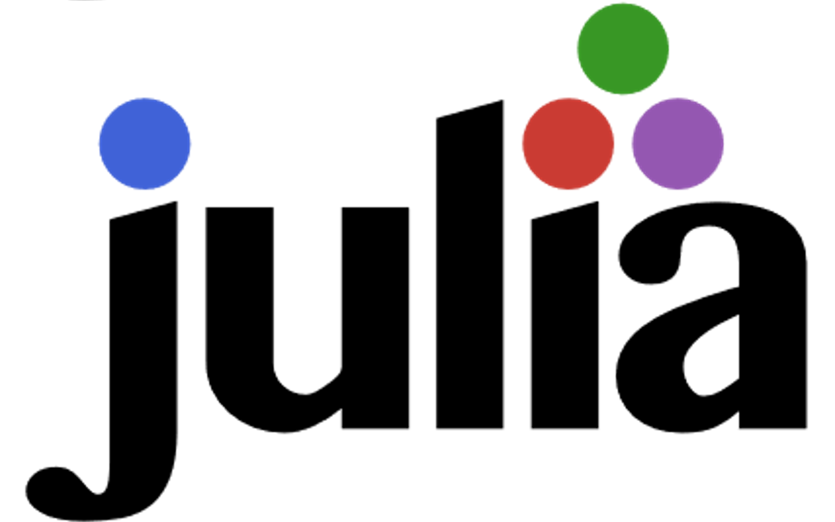

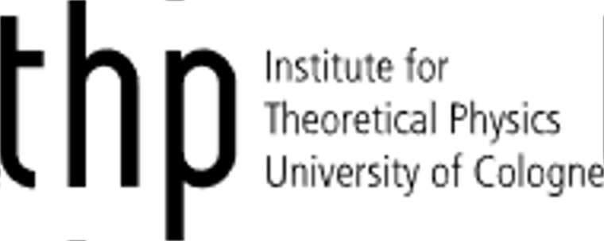
A programming language specifically made for scientists
Carsten Bauer @ University of Cologne, October 2019

Slide 2
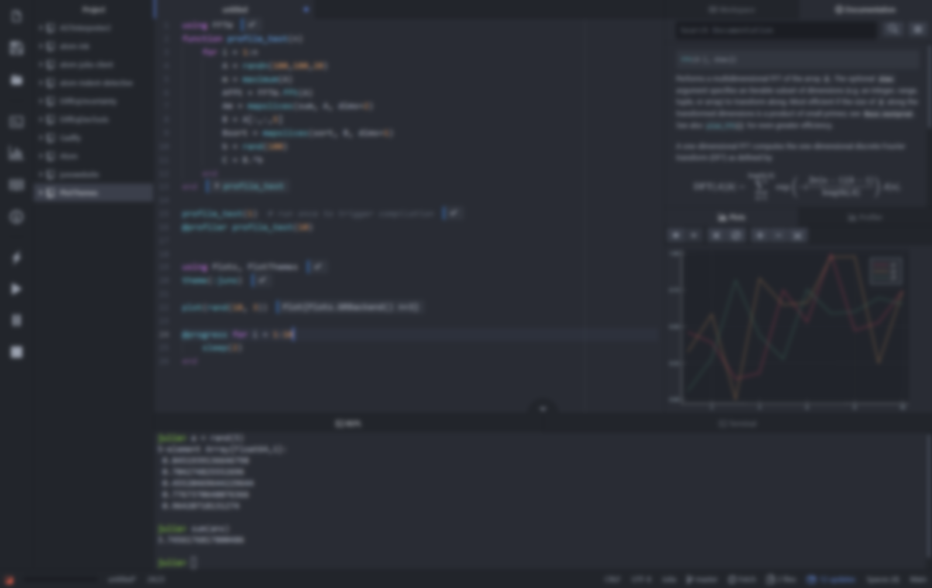
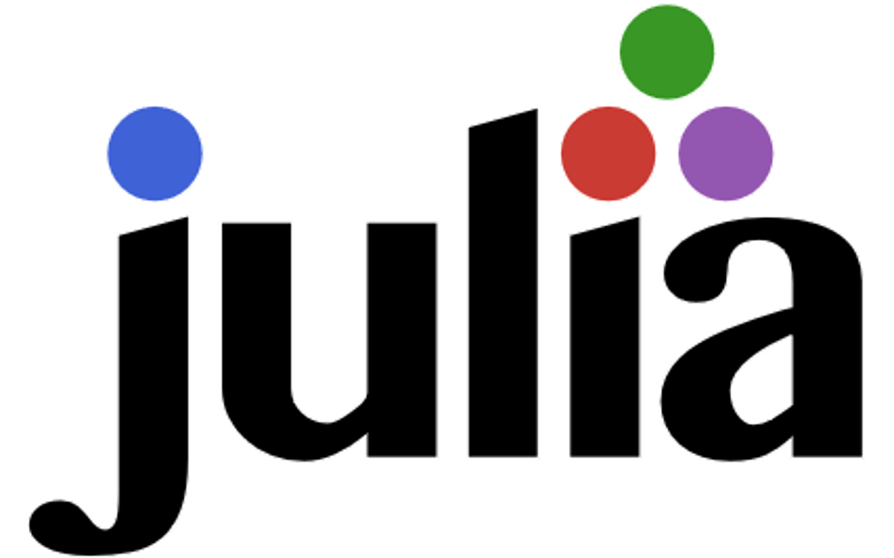
The programming language for scientists
Carsten Bauer @ University of Cologne, October 2019

Slide 3


What does science need from a programming language?
Easy to write, read, and understand
Fast and scalable
Interactive

Slide 4
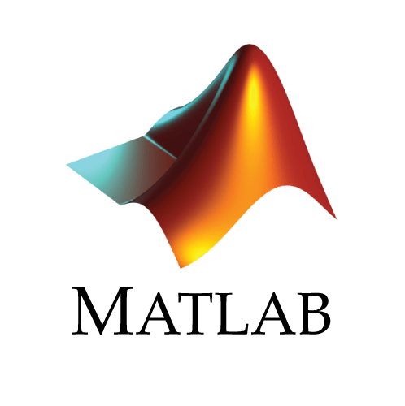
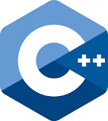
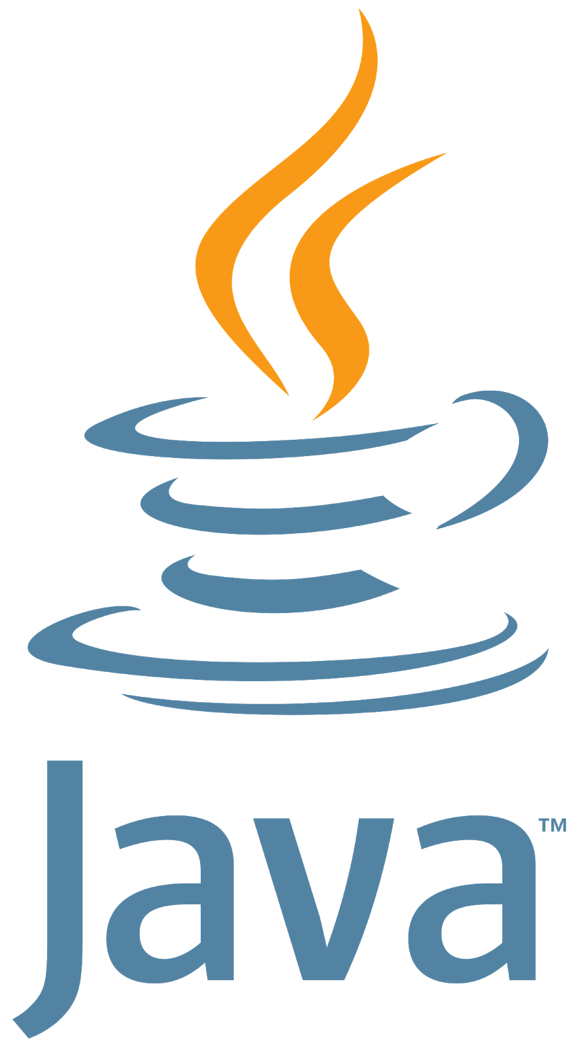




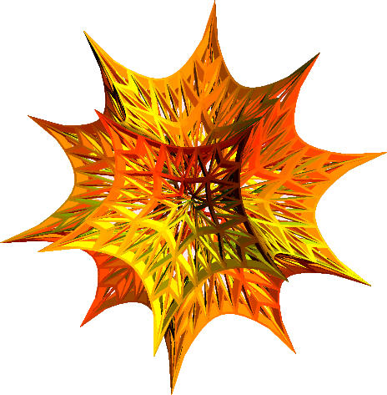
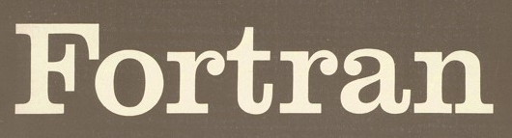
There’s a plethora of programming languages

Slide 5
There’s a plethora of programming languages

Slide 6
There’s a plethora of programming languages
Slow(ish)
Fast

Slide 7
There’s a plethora of programming languages
Compiled
Interpreted

Slide 8
There’s a plethora of programming languages
Static
Dynamic

Slide 9
There’s a plethora of programming languages
Speed
Convenience

Slide 10
The “two language problem”
a.k.a Ousterhout's dichotomy
Prototype
Production

Slide 11
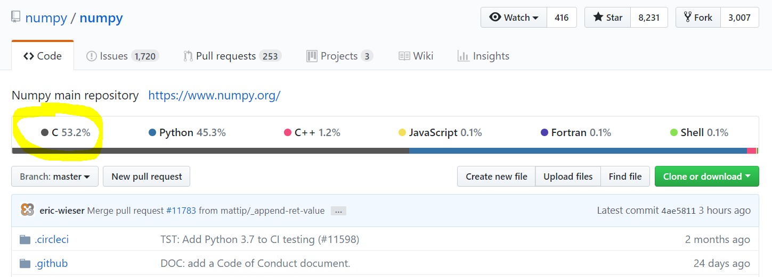
The “two language problem”

Slide 12

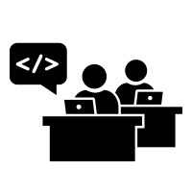

The “two language problem”
User
Developer

Slide 13
The “two language problem”
static
dynamic
compiled
interpreted
user types
standard types
standalone
glue

Slide 14
dynamic
compiled
user types
and
standard types
standalone
or
glue
“Feels like Python, runs like C”

Slide 15
What do we want from a PL?
The unification
Simple yntax + grammar
Simple syntax + grammar
Fast answers
Interactivity

Slide 16
What do we want from a PL?
The unification
function babylonian(α; N = 10)
@assert α > 0 "α must be > 0"
t = (1+α)/2
for i = 2:N
t = (t + α/t)/2
end
t
end
babylonian(π) ≈ √π
Simple syntax + grammar
Fast answers
Interactivity
“Feels like Python, runs like C”

Slide 17
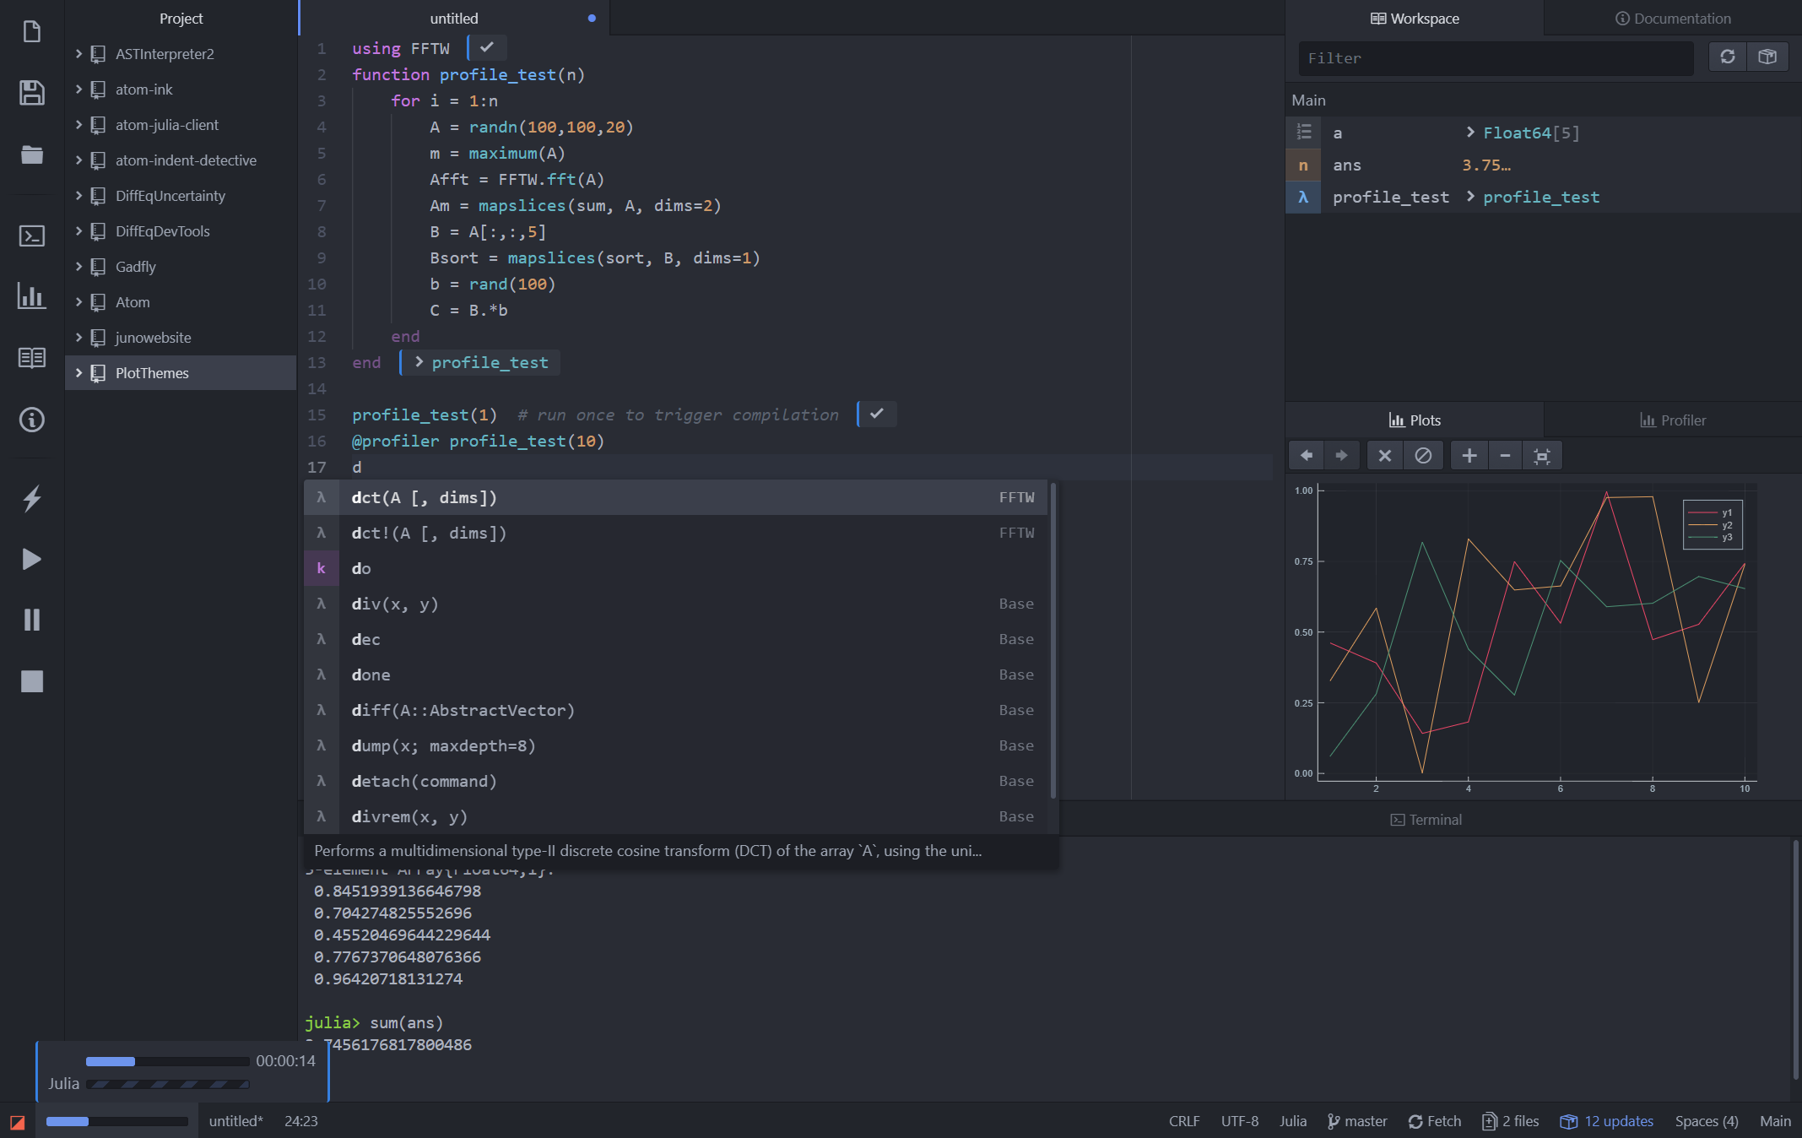
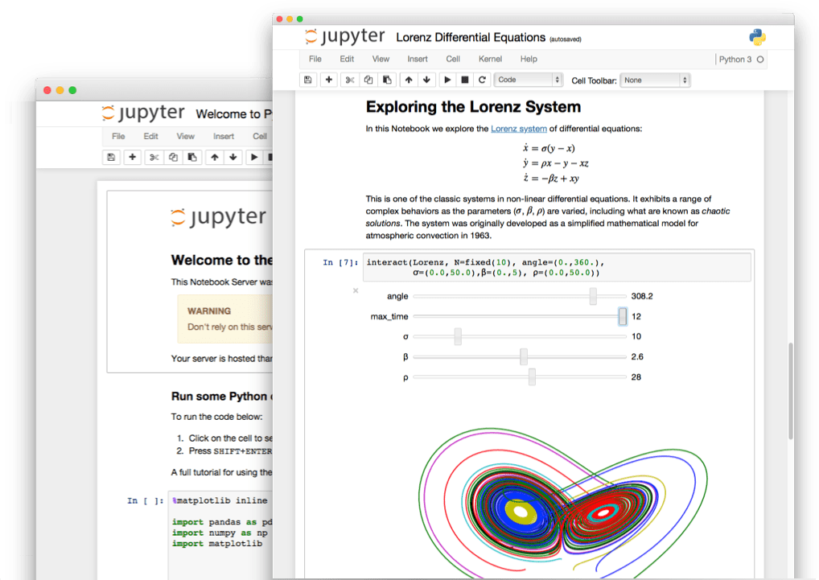
What do we want from a PL?
The unification
Simple yntax + grammar
Simple syntax + grammar
Fast answers
Interactivity
“Feels like Python, runs like C”

Slide 18
What do we want from a PL?
The unification
julia> function sumup()
x = 0
for i in 1:100
x += i
end
x
end
sumup (generic function with 2 methods)
julia> @code_llvm debuginfo=:none sumup()
; Function Attrs: uwtable
define i64 @julia_sumup_12626() #0 {
top:
ret i64 5050
}
Simple yntax + grammar
Simple syntax + grammar
Fast answers
Interactivity
Just returns the answer!
(The for loop was compiled away)
“Feels like Python, runs like C”

Slide 19
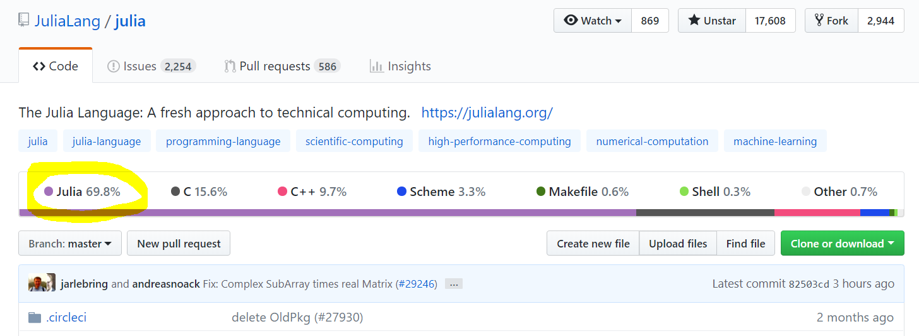
It is free and open source

Slide 20
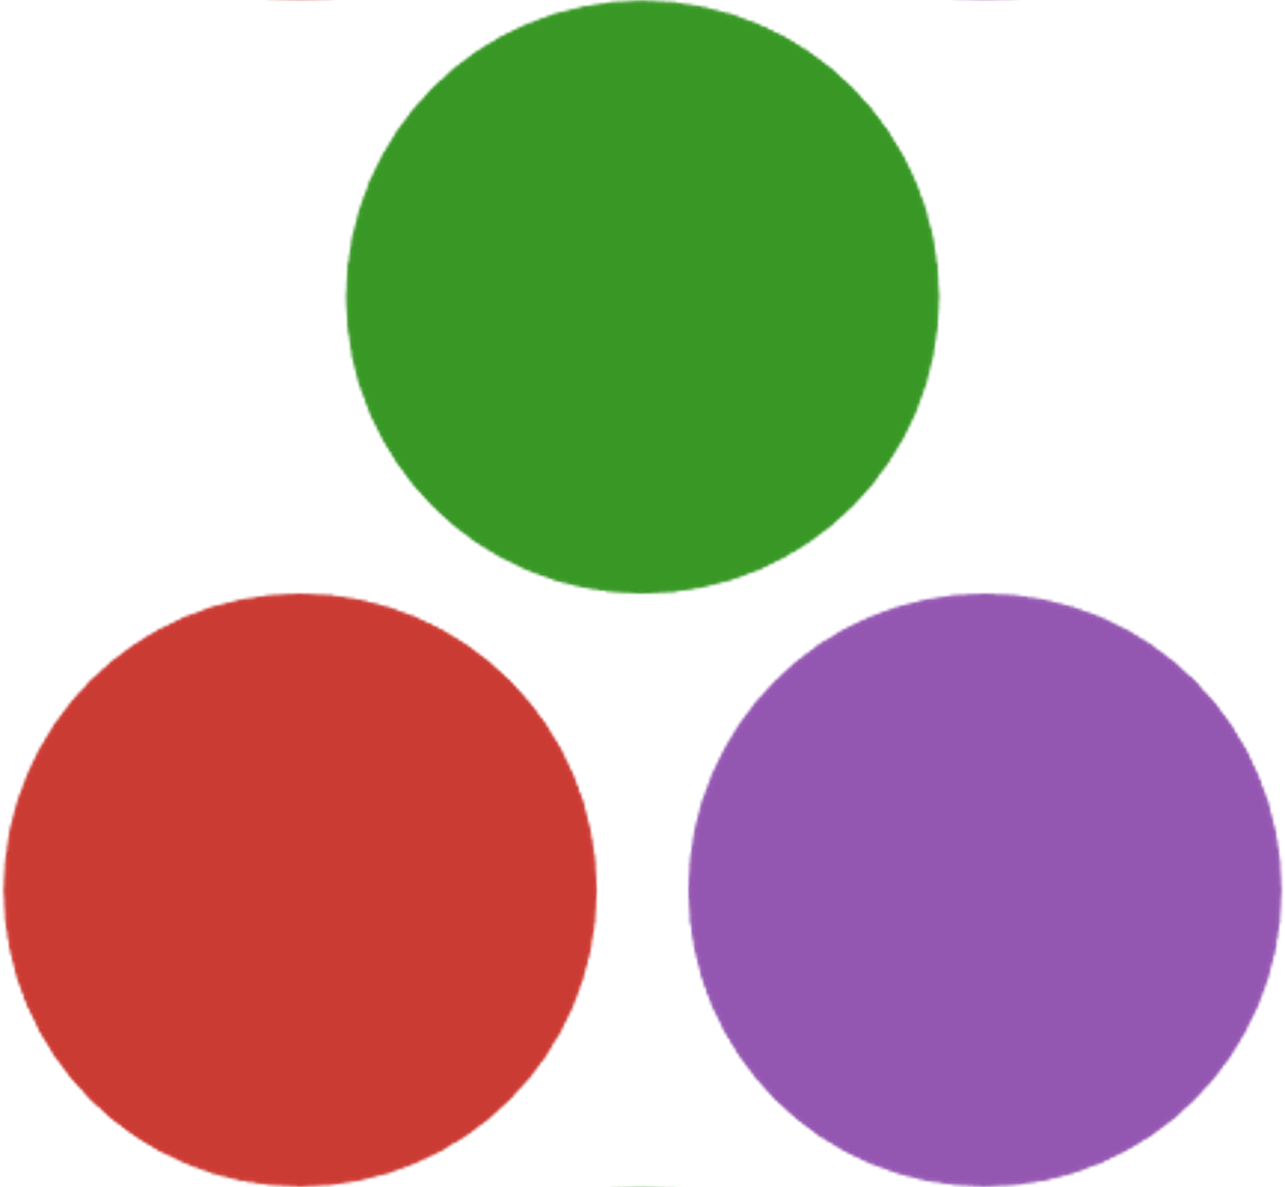
It is inviting
User
Developer

Slide 21
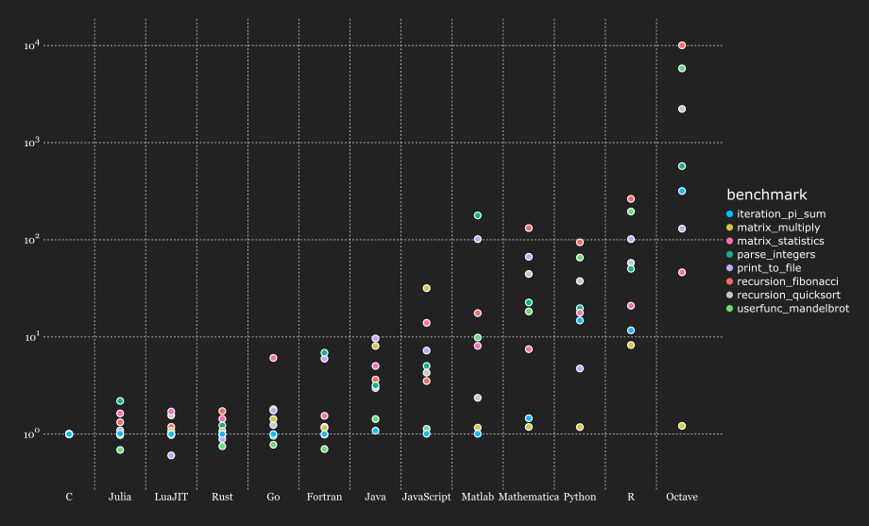
It is fast

Slide 22
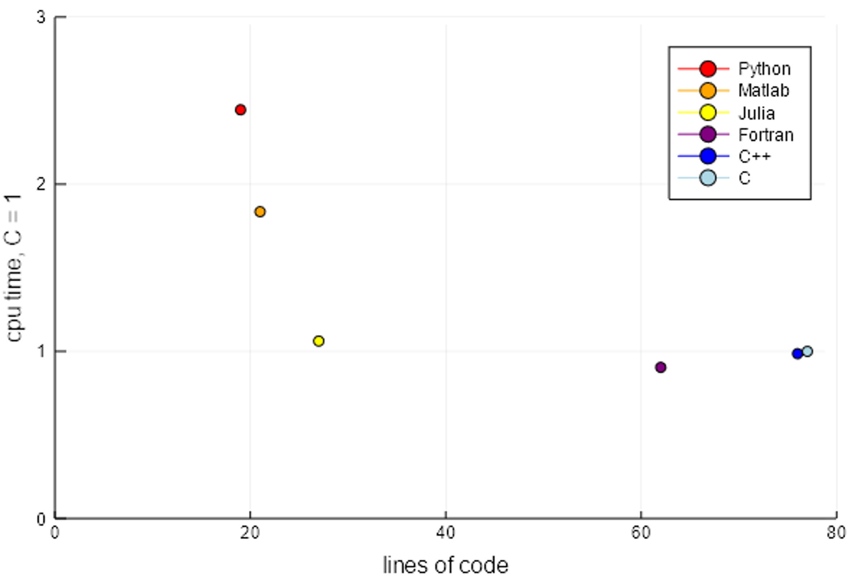
It is expressive

Slide 23
Background information
Begun in 2009 as part of Jeff Bezanson's PhD thesis @ MIT.
First major release of Julia 1.0 in August 2018.
already > 2 million downloads
~750 core language contributors
1600+ external packages

Slide 24
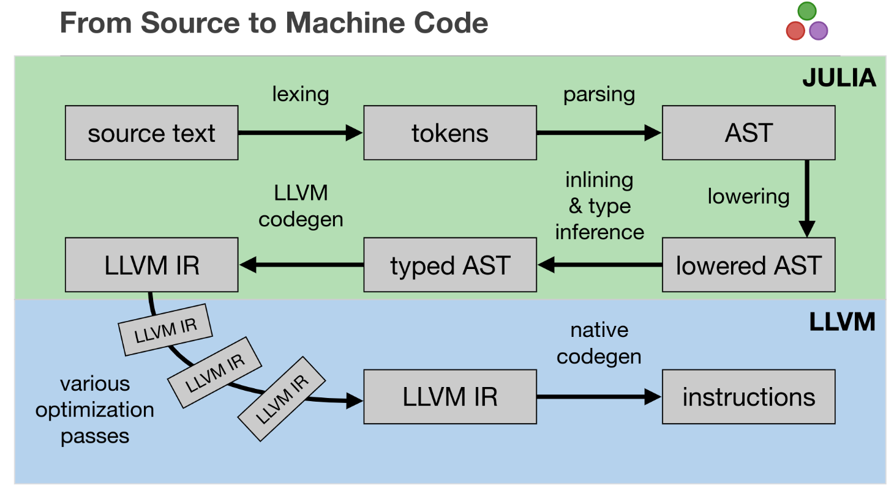

Slide 25
Recommended talks
Nick Eubank: What Julia Offers Academic Researchers
George Datseris: Why Julia is the most suitable language for science

